Slide 1

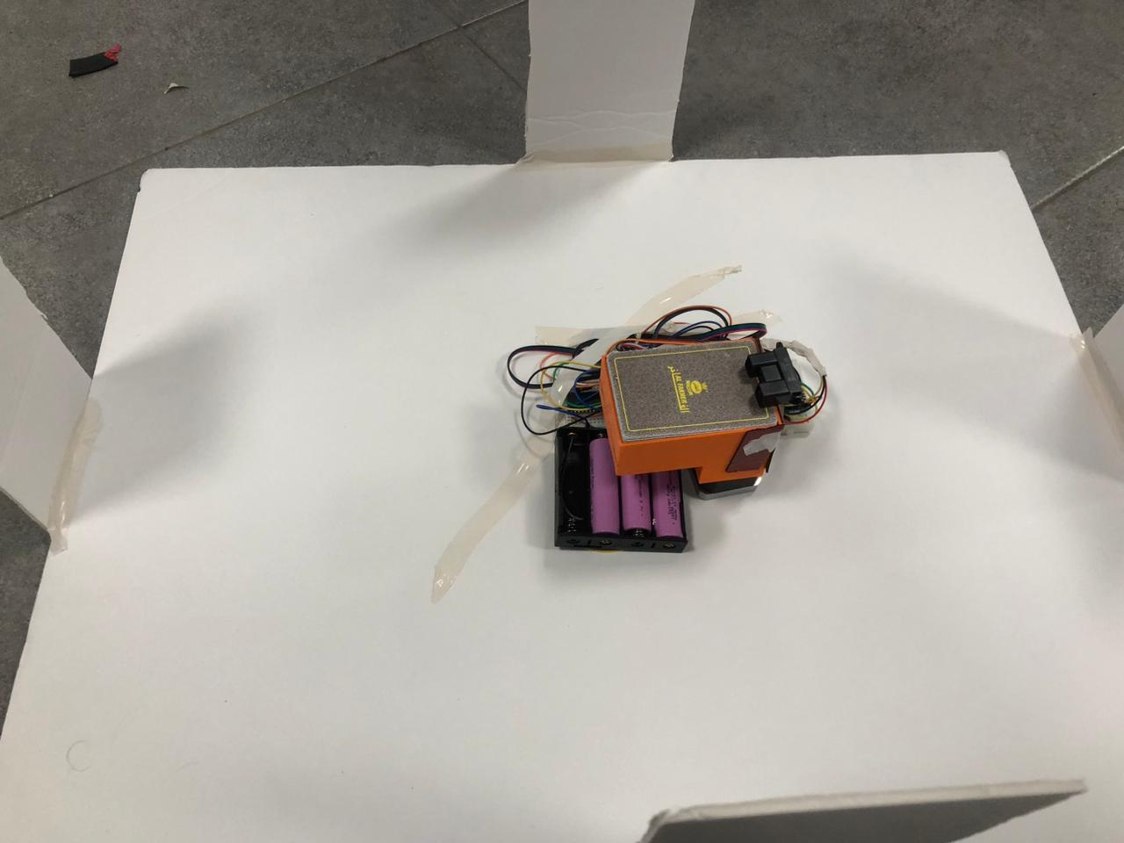
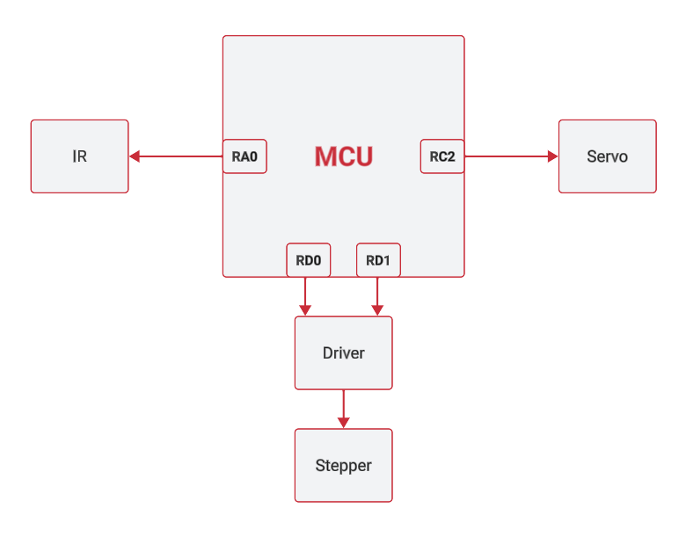
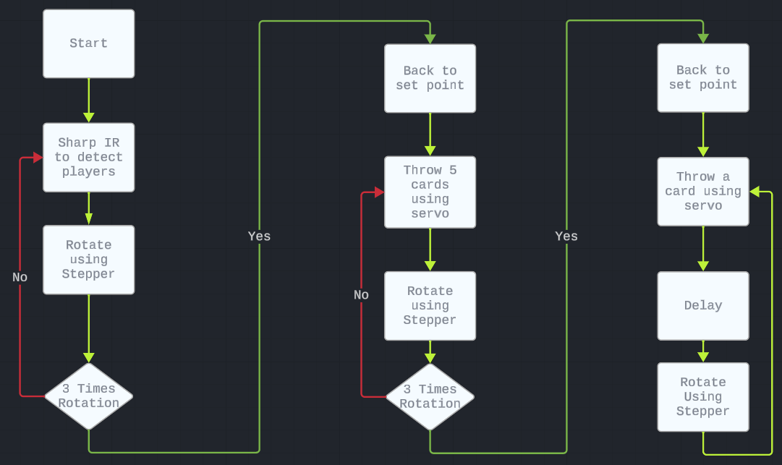
Title that hints at the underlying issue or project purpose/goal
Ahamd melhem, Basil Alsarayra, Abdalrhman musleh
Supervisor: Dr. Belal Sababha
Embedded Systems Final Design Project, 2024
King Abdullah II School of Engineering
Princess Sumaya University for Technology
Introduction
This automated system aims to revolutionize traditional card game setups, providing a seamless and dynamic distribution process that eliminates the manual effort associated with handling and dealing cards. Beyond its functional aspects, the project reflects a commitment to innovation in gaming technology, enhancing user engagement and fostering an immersive gaming experience
In summary, the development of the Automated Card Distribution System using PIC 16F8778 marks a significant advancement in enhancing card game dynamics. Leveraging technologies like the Sharp IR sensor and stepper and servomotors, the system streamlines card distribution, offering a seamless and adaptable gaming experience.
Results
After assembling all the hardware and software components and installing them on the base with the game, we got our final product as shown in the pictures below:
Figure : Automated Card Distribution.
Figure : diagram
The Automated Card Distribution System operates through a systematic process facilitated by the Sharp IR sensor, stepper motor, and servomotor.
Initially, the sensor detects players, prompting the stepper motor to move to the next set point. This sequence repeats to accommodate additional players.
In the second round, the servo dispenses five cards to a player, and the stepper advances to the next player.
From the third round onwards, the servo dispenses one card with a 20-second delay, after which the stepper rotates to the next player. This cyclic process optimizes card distribution, enhancing the gaming experience.
Design
The stepper motor facilitates a 360-degree rotation of the cardholder, while the servomotor efficiently propels cards from the holder to the table.
The integration of the Sharp IR sensor ensures precise detection of the number of players and their positions, contributing to an accurate and dynamic card distribution process.
Conclusion
In summary, the development of the Automated Card Distribution System using PIC 16F8778 marks a significant advancement in enhancing card game dynamics. Leveraging technologies like the Sharp IR sensor and stepper and servomotors, the system streamlines card distribution, offering a seamless and adaptable gaming experience.
In essence, this project exemplifies the fusion of technology and gaming, showcasing how automation can enhance traditional experiences. The system promises to redefine card game dynamics, providing both convenience and a novel dimension to the enjoyment of playing cards.

